Slide 1
Effective Writing
Where and how to start?
Notes:
Welcome to the Effective Writing presentation for US Army War College Department of Distance Education Students. The Purpose is to provide a tutorial on navigating the information within DDE online courses, while paying particular attention to the main written requirements.
Next Slide

Slide 2
Table of Contents
Lesson 1 (power point #1)
Introduction
Course Directives
Course Readings
Tab for endnotes
Tools available
Lesson 2 (power point #2)
Drafting your outline
Type of Essay
5 paragraph paper
Lesson 3 (power point #3)
Microsoft Word Grammar and style check
Checking paragraphs
Lesson 4 (power point #4)
Techniques to Drafting your Paper
Outline to draft paper
Notes:
The presentation contains two lessons. (click) This is lesson #1 and will review the importance of Course Directives, Blocks, and available tools regarding the written requirements. (click)
The Second lesson of the presentation will provide a technique in drafting papers. (click)
The Third lesson reviews how to use the Microsoft Word grammar check. (click)
The Fourth and final lesson will provide techniques applying the outline to a draft paper.
The overall goal is to better prepare students to submit successful writing assignments.
Next Slide

Slide 3
Notes:
The next few slides provide a quick overview on navigating through a typical DDE Army War College online course. Each course will be available to all students on a given day, which has been provided in the class schedule or in a e-mail. It is important to enter the course on the posted day or very soon after. (click) Once the course is available on-line, you should take the time and READ all of the Directive and individual blocks for the course. (click) The Directive and Blocks provide the 5 w’s (who, what, when, where, and why) in order to successfully draft and submit your written assignments. This presentation is going to provide the “How” regarding the written assignment. This presentation provides a technique which worked for one previous DDE student. Please understand there are many different techniques you can use. However, at the conclusion of this presentation, the goal is to provide you with enough information to create your individual technique for submission of successful written assignments.
In this example, (click) lets take a look and the Directive for Course DE2200. Each course is for the students (answers the WHO), and the Directive provides the WHAT. Oh by the way, this is an older Orientation Course and is for demonstration purposes only. PLEASE do not substitute this example for your assigned Orientation Course.
First thing is the Directive (go to next slide)

Slide 4
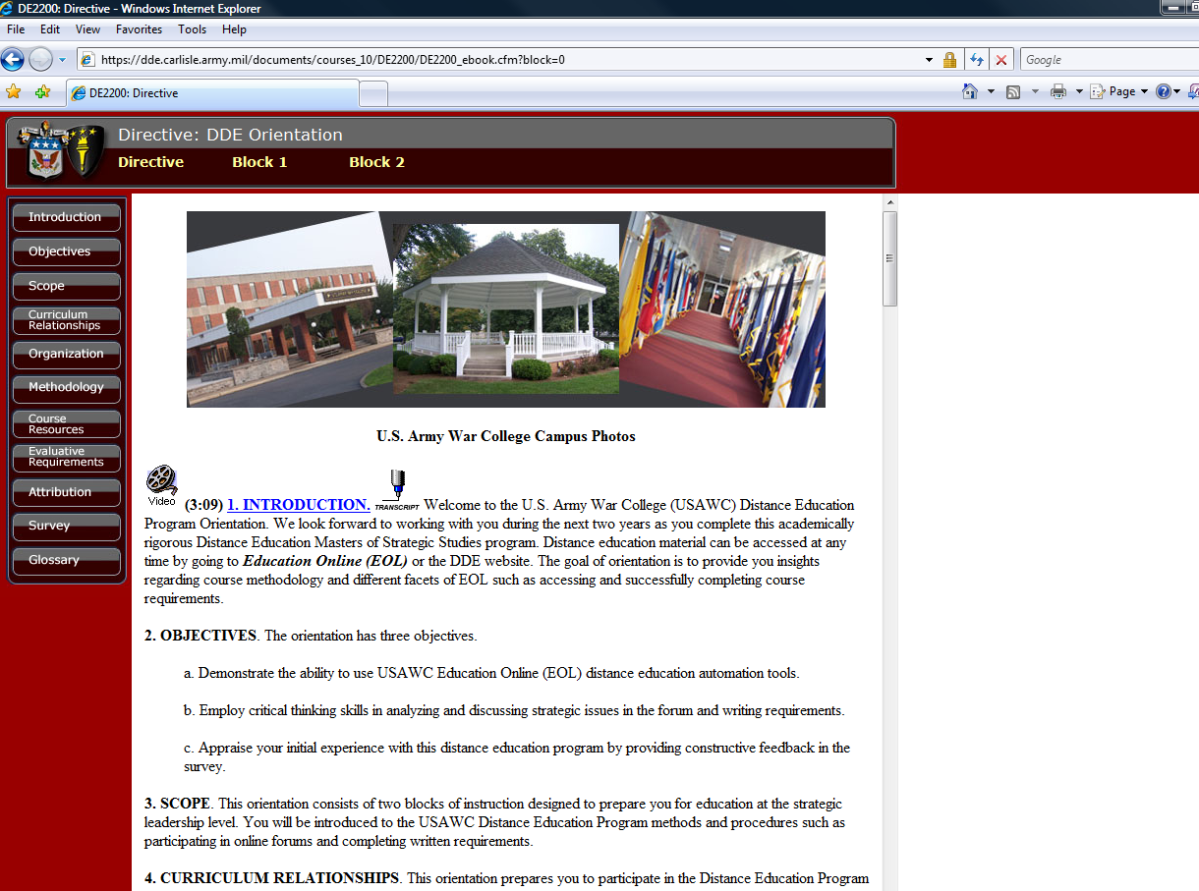
Notes:
Remember, to not skip over the other parts of the Directive. The Directive portion in all online courses provides (click) most of the information you need to understand the course. As previously stated, it is VERY important to understand the Directive and Blocks for each course. Some students would print these for a hard copy, some copied into a word document and saved on their personal computers, and others continually accessed the information off the USAWC web site. Each student finds a way that works best for them. The point here is that you NEED to read and understand the information BEFORE you start reading or writing anything.
Again, once the directive is reviewed in its entirety, start keying in on when requirements are due. (next slide)

Slide 5
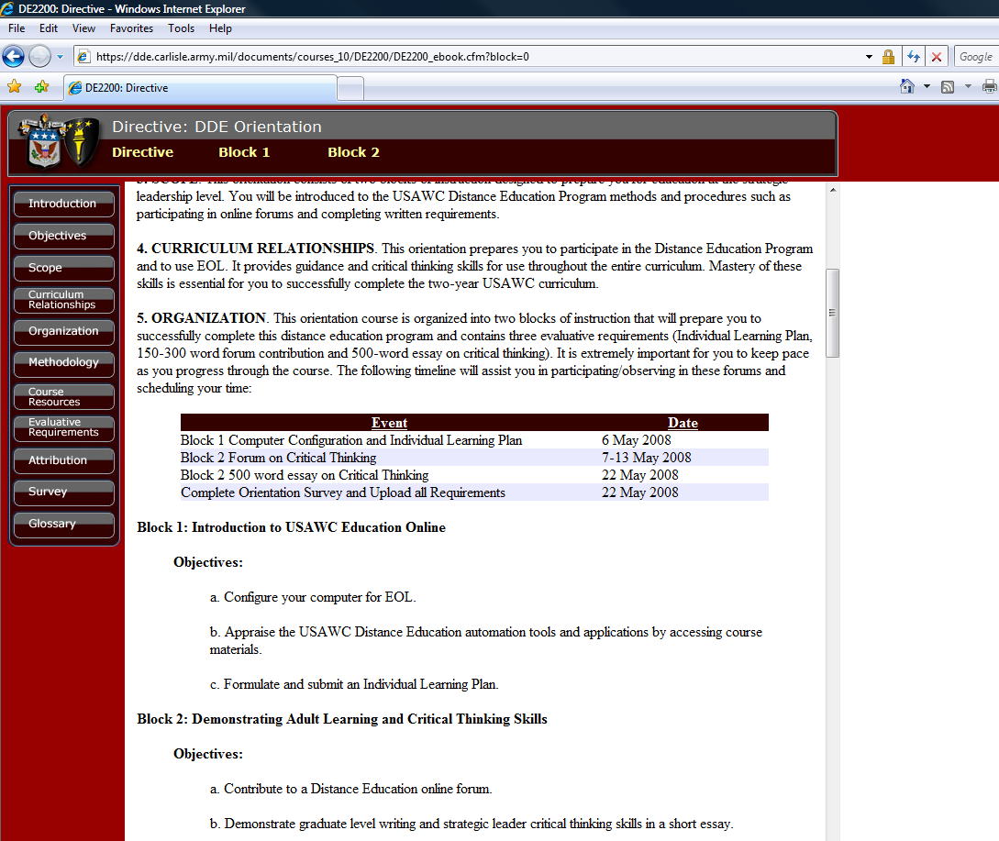
Notes:
Each student should read all of the Course Directive at least once and then go back to certain sections for more clarity if required. One technique is to fully understand the timeline and specifically, when each requirement is due to the evaluators. Building your timeline using the backward planning approach might work best for you.
For example, in this course, there are three main deadlines. (click) These dates answer the “WHEN”. In addition to when papers are due, directives also provide timelines for student forums and DCOs otherwise known as Direct Connect Online and these events are evaluated as well. However, (click) this presentation will focus the written requirement and in this case, a 500 word essay on Critical Thinking.
Thus far in this presentation, the Who, What, and When are addressed. Now the “where,” “why,” and “How”.
(next slide)

Slide 6
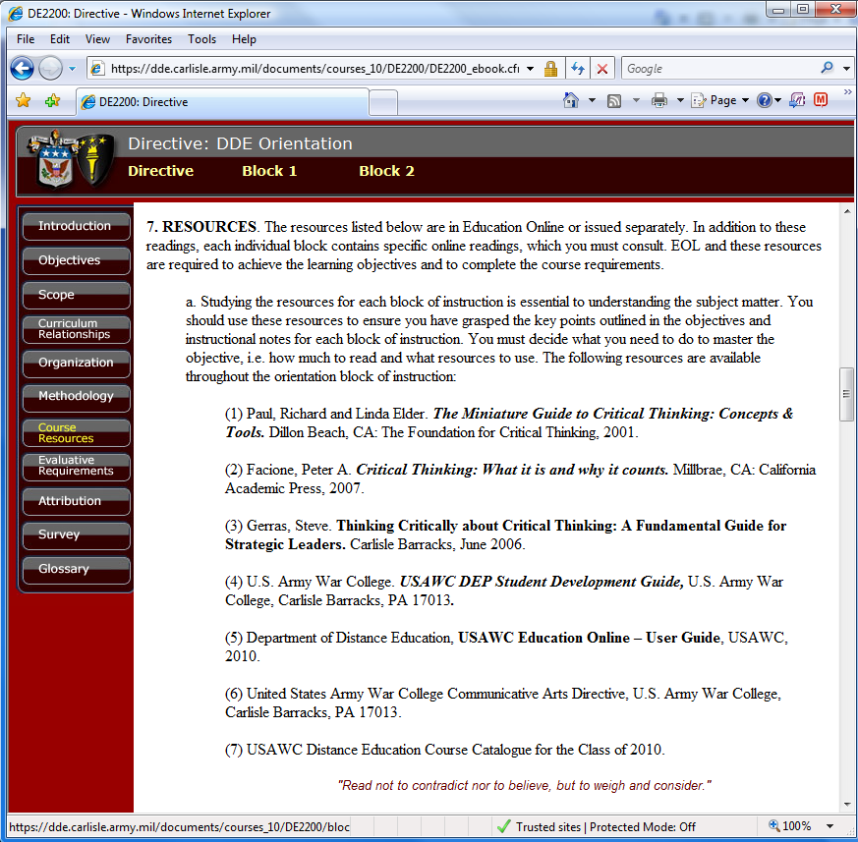
Notes:
The WHERE refers to the location of materials required to complete the written assignment.
Remember, do not skip over the other parts of the Directive. The Directive portion in all online courses provides (click) very important information for successful completion of each on-line course.
This slide depicts the Orientation Course Directive and the course resources (click). Again, focusing on the written requirement, you need to know the material required (click). However, additional resources may be required and if so, will be depicted in the (click) Blocks of information as we will see later in this presentation.
Now you need to know the evaluation criteria.
(next slide)

Slide 7
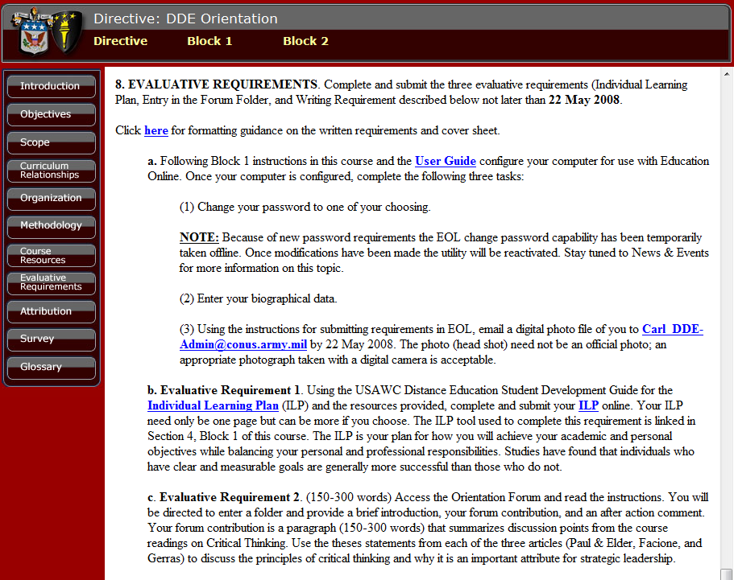
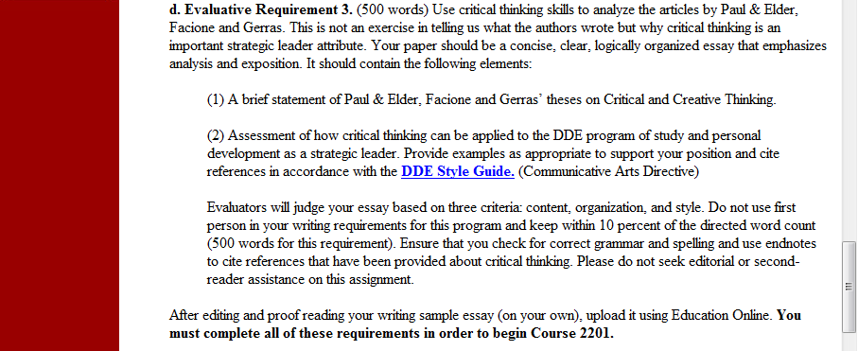
Notes:
It is very important to understand the evaluation criteria for each course. In this presentation, evaluation #3 will be reviewed. This is not to say evaluation requirements 1 (click) and 2 are not important (because they are important) however, since this presentation centers on the main written requirement in this course and other courses within DDE, requirement number 3 will be analyzed further.
(next slide)

Slide 8
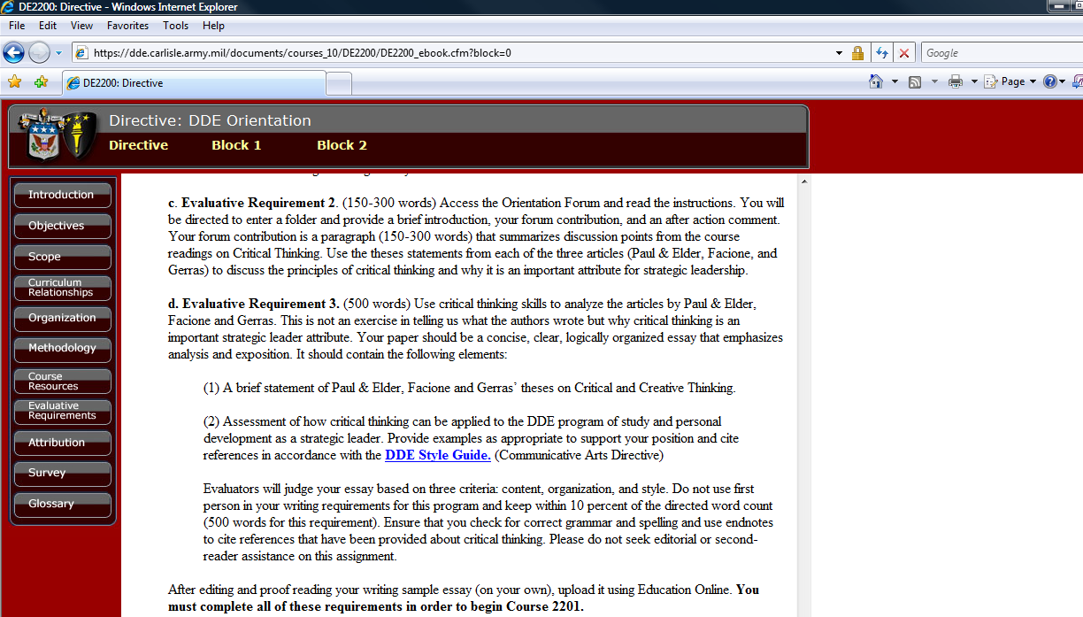
Notes:
Carefully read and re-read the requirement. (click) First key criteria is the fact that the essay is 500 words. (click) The second key criteria is the fact that the student analyzes articles. (click) The requirement further directs the resources you should use. In this case the article by Paul and Elder, Facione, and Gerras.
Now this evaluation requirement provides additional direction regarding the essay. (click) In this case, the course author does not want a 500 word essay on what the article authors wrote. (click) However, the course author does want to know why critical thinking is an important strategic leader attribute. (click)
Going back (click) to the word “analyze” in this requirement for a moment. This word is considered an Instruction word. Other instruction words would include: Compare; Contrast; Define; Describe; Discuss; Evaluate; Explain; Interpret; Outline; Review; ect… The DDE program provides links to various writing sites which define these terms.
(next slide)

Slide 9
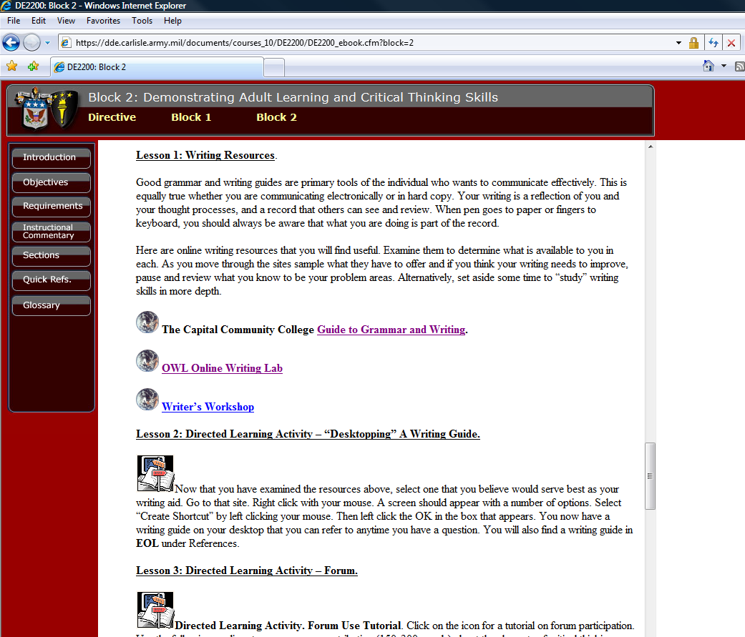
Notes:
For example. In any of the DDE on-line Orientation Courses, the writing resources are listed. (click) In this example to find a definition for “analyze” you could select the OWL Online Writing Lab.
(next slide)

Slide 10
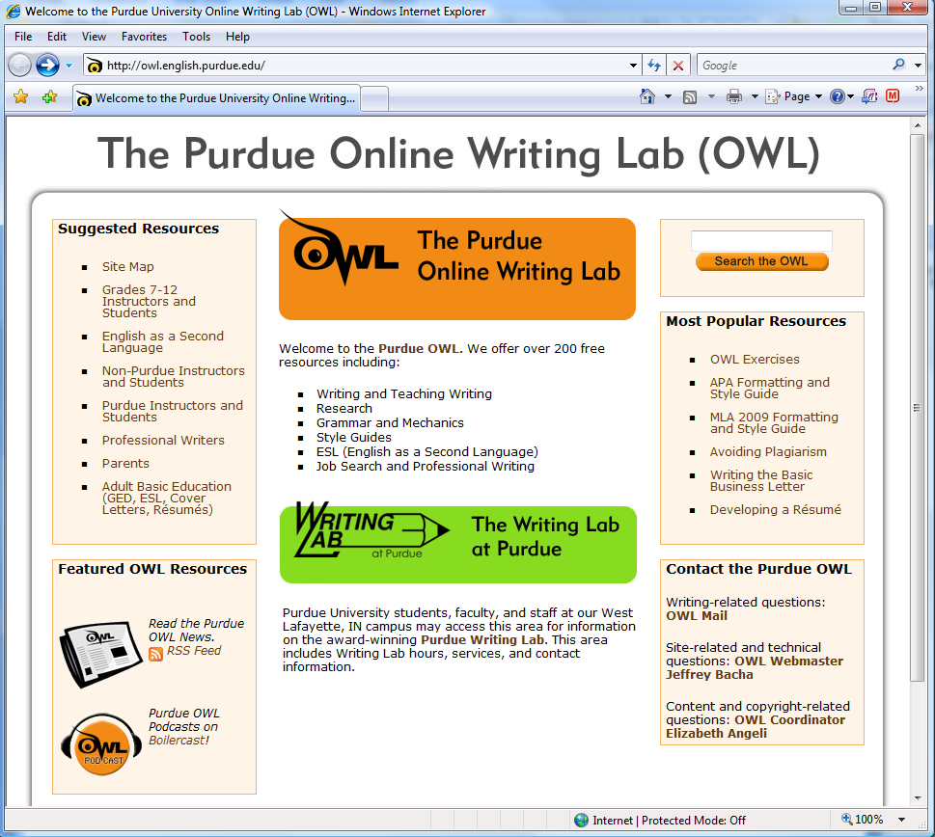
Notes:
The Purdue Online Writing Lab provides a lot of good information regarding writing papers. (click) Again, in this case the student may want to better understand the definition of “analyze” in the writing requirement. Select non-Purdue Instructors and Students.
(next slide)

Slide 11
Notes:
Then select (click) starting the writing process.
(next slide)

Slide 12
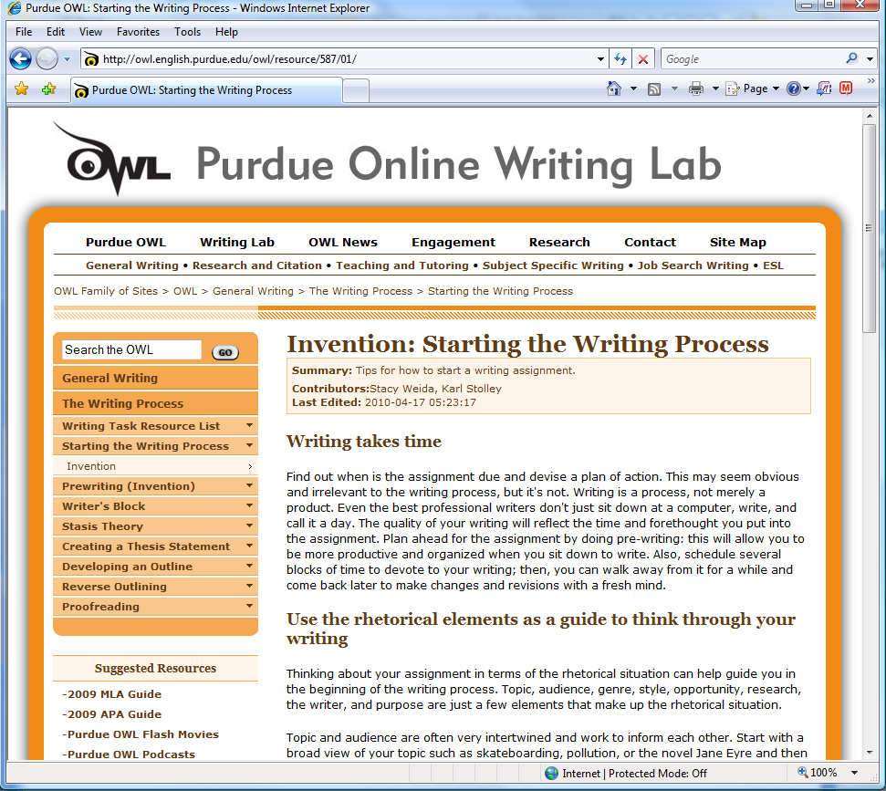
Notes:
Starting the Writing Process page has some very good information. Scroll down this page to…
(next slide)

Slide 13
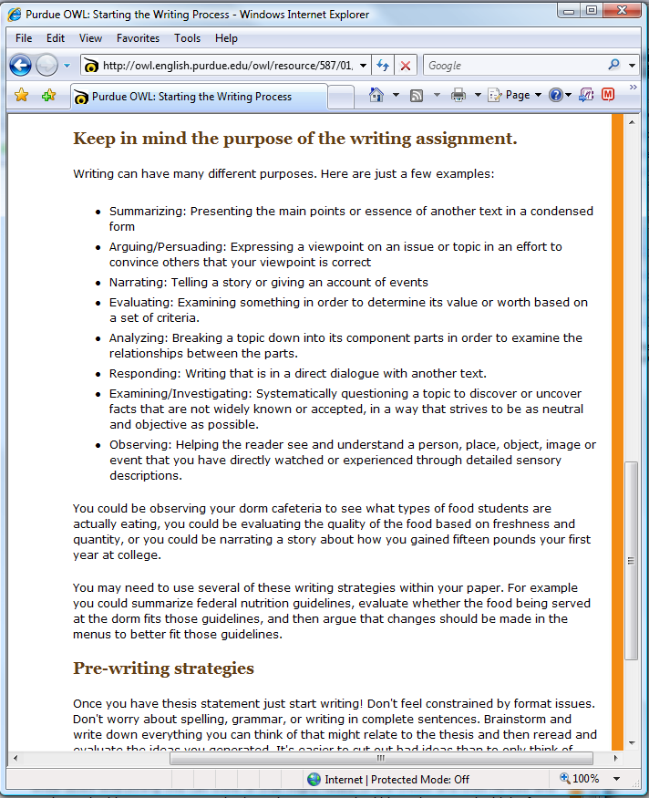
Notes:
the purpose and specifically, Analyzing. The point here is that many on-line references are available to better understand written requirements. For example, another online reference is the University of New England on line, where the term Analyze is defined as, “Focusing on the how and why of an issue or topic, and not simply a description or summary. Therefore, our essay will depict how and why critical thinking is an important strategic leader attribute.
Now the term analyze is understood, lets go back to the written requirement again for additional guidance.
(next slide)

Slide 14
Notes:
Additional guidance indicates that (click) we need a BRIEF statement on the theses by Paul and Elder, Facione, and Gerras. Knowing we only have 500 words, chose the amount of words to briefly state the theses carefully.
The guidance continues to instruct that the paper must include an assessment (click) on how critical thinking can be applied to the DDE program and personal development as a strategic leader.
There appears to be two criteria in this guidance. (click) The guidance continues to state we must provide examples to support our position and (click) cite references. This guidance also directs our attention to the DDE Style Guide in the Communication Arts Directive regarding how to cite references. More on that later however, the take away is while you read the material, keep track of your references (i.e. article, author, and page) you might use in your paper.
One final note in this guidance. The paper will be evaluated (click) on content, organization, and style. (click) This includes not writing in the first person, (click) but does require using correct grammar, endnotes, and maintaining the correct word count. Finally, (click) this requirement requires the paper to be 500 words, within 10 percent. This mean no less than 450 words total and no more than 550 words total. More to follow on how to use the “word count” in Microsoft word program.
(next slide)

Slide 15
Notes:
(click) The directive and written requirement for this course has been reviewed. Most of the who, what, when, where, and why have been addressed. (click) The Block information provides additional information and resources in order to complete all the evaluation requirements. If we were going to complete the first and second evaluation criteria, Block 1 would contain the additional information. (click) For brevity, we will only center on the 500 word paper which is evaluative requirement #3 and Block 2 contains the additional information for our paper. The take away however, is that you NEED to read all of the Directive and Blocks for information to successfully submit any written requirement.
On to Block 2.
(next slide)

Slide 16
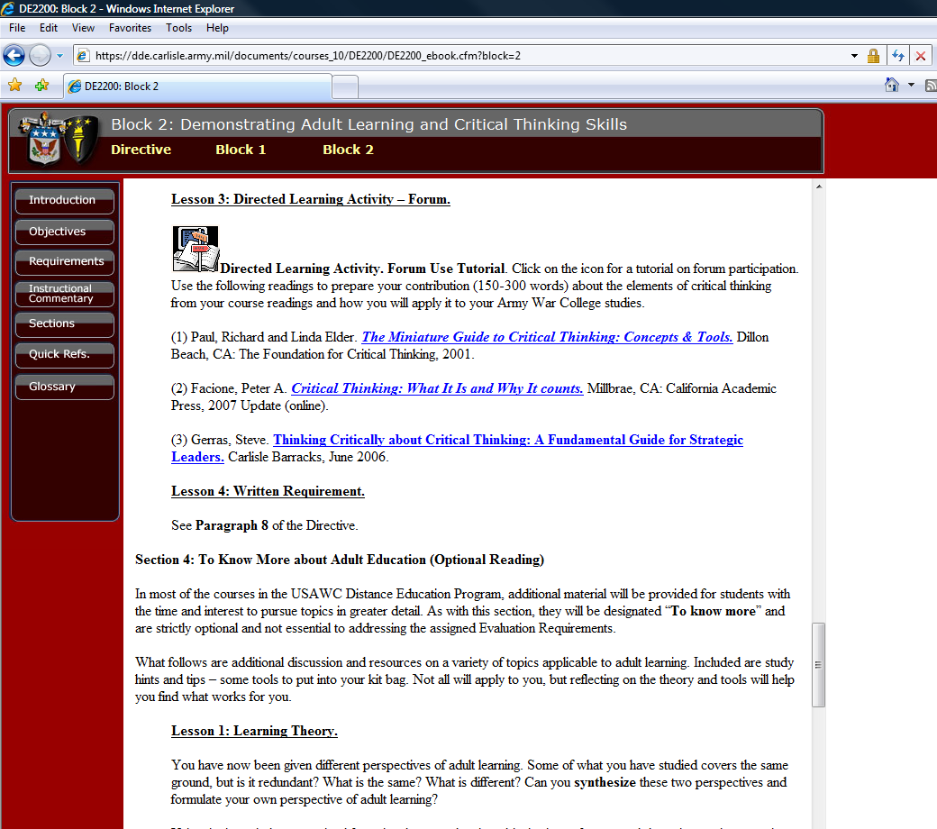
Notes:
Scrolling down Block 2, (click) the theses by Paul and Elder, Facione, and Gerras are found. Many of the reading assignments are hyper linked and you may print off a hard copy or save on your computer. As previously stated, you select the technique that works best for you. The important take away is that you need to cite information used from these articles.
(click) Another point here is the written requirement. Here, this lesson points to the directive as the location for information on the written requirement for this assignment. If you never read the Course Directive and Blocks carefully, you may miss this crucial piece of information.
(next slide)

Slide 17
Notes:
One last slide on the “Where” we find information for our paper. If you did not finish your thorough review of the Directive and Blocks because you rushed to the articles by Paul and Elder, Facione, and Gerras referenced in the written assignment, you would have missed other pieces of information available on critical thinking. (click) Here for example, are more articles, videos and audios on critical thinking. The other DDE course are organized in a similar fashion. So PLEASE read before you write.
(next slide)

Slide 18
Notes:
Now we understand how to use the online Directive and Blocks in each course to identify the written requirement; resources; and on line tools available to assist use in drafting papers. The next lesson will be Techniques to outling.

