Slide 1
Using the Microsoft Word Grammar and Style check
Notes:
During your two years in the DDE program, you will write many papers. Although there are no tools for content, analysis, and critical thinking elements of your paper, there are some tools in Microsoft word which will assist you in identifying many grammatical and style errors.
Next Slide

Slide 2
Notes:
For example purposes, lets take a basic paragraph we have typed using Microsoft Word. The paragraph looks good
with no spelling errors. However, before you hit the “send to evaluator” button, you should ensure your grammar and style are good to go.
Next Slide

Slide 3
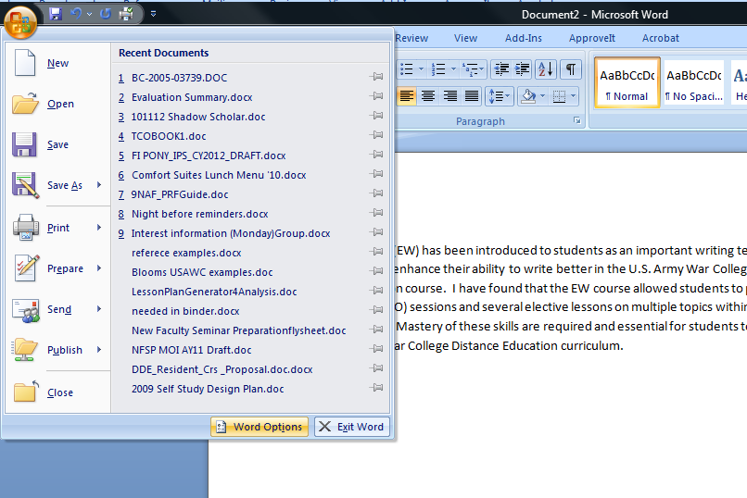
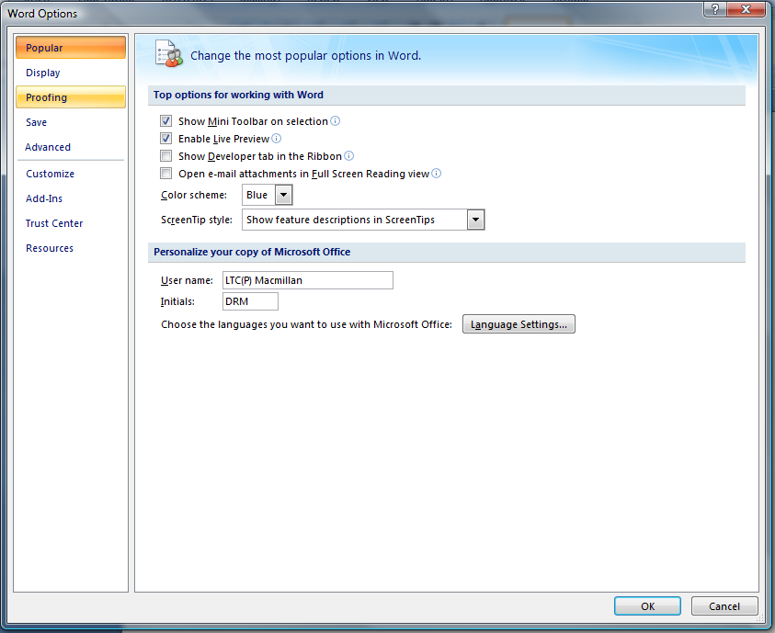
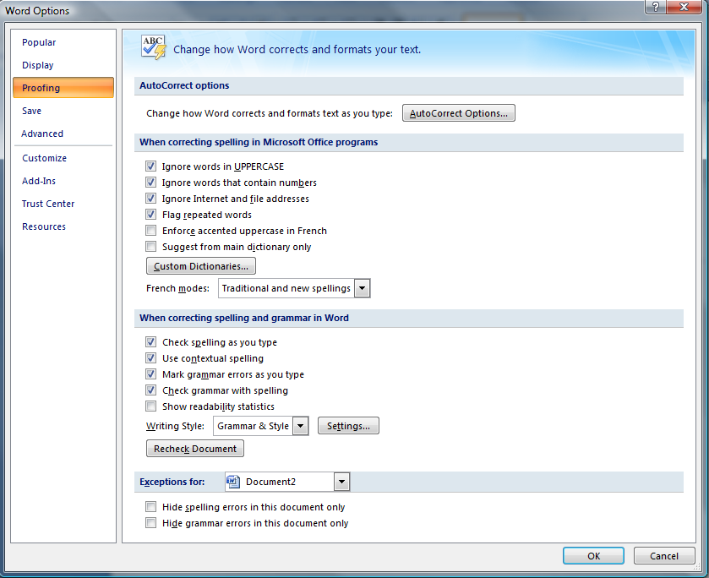
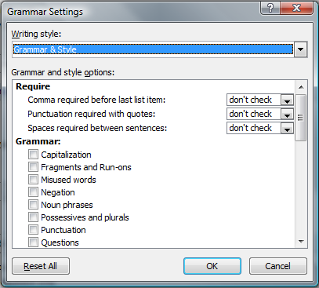
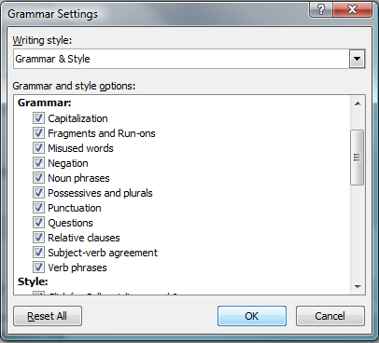
Notes:
(click) While still in Microsoft word, the first thing we need to do is (click) Select Microsoft icon and (click) then Word options. (click) The word options box will appear and the second thing to do is to select (click) proofing and ok. (click) The proofing box will appear and the third thing is to (click) select settings. (click) The settings box will appear and the fourth thing is to (click) make sure Grammar And Style are checked (Click) and then (click) select ok.
Next slide

Slide 4
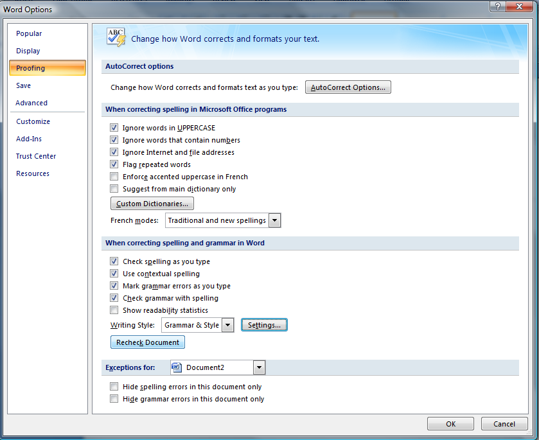
Notes:
The fifth and last step is to (click) select the “recheck document” button and then (click) select ok. Now your (click) paragraph indicates several (click, click, and click) green underlined areas. These underlined areas indicate potential grammatical errors. (click) Not to worry, there is a method to this madness.
Next Slide

Slide 5
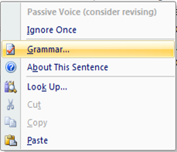
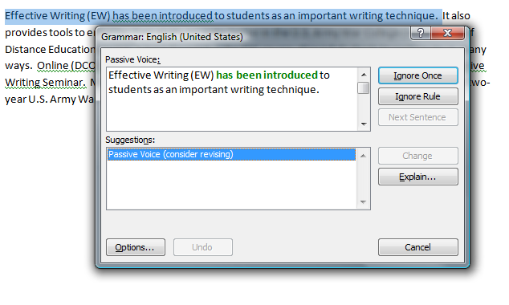
Notes:
The first (click) thing you do is move (click) your mouse cursor on the green underlined portion and right click your mouse. (click) a dialog box will appear and then (click) select “Grammar”. (click) Another dialog box will appear and show you the grammatical issue. In this case, (click) it is passive voice and the dialog box recommends you revise the sentence. Follow these same procedures for all areas in your text which are highlighted with green underline until you have corrected the grammatical issues.
Next Slide

Slide 6
Notes:
(click) Now our paragraph has been correct and revised per the Microsoft grammar check. Take a moment and compare it (click) to the original paragraph.
Next Slide

Slide 7
Using the Microsoft Word Grammar and Style check
Notes:
As previously stated, during your two years in the DDE program, you will write many papers. Your paper’s content, analysis, and critical thinking elements must still be graduate level material. However, there are some tools in Microsoft word which will assist you in identifying many grammatical and style errors and ultimately, help you achieve a paper with few grammatical errors in it.

