Slide 1
Techniques to Outlining
Notes:
Welcome to the US Army War Colleges Department of Distance Education presentation #2 on Techniques to Outlining. This presentation will provide an overview on outlining techniques. It is only one of many techniques students use to better organize papers to ensure the evaluative requirements are captured in the content of the paper and that the paper has a logical flow.
Next slide.

Slide 2
Outline
Is a schematic representation that shows a hierarchical relationship or logical ordering of information in your paper.
- Contains major points you want to write about in your paper.
Notes:
You can find many definitions of an outline however, each of those definitions depict outlines as being schematic in ordering of information in your paper or essay. Ordering of information meaning your paper has an introduction first; the a main body with several key ideas; and lastly a conclusion.
Next slide.

Slide 3
References
Purdue Online Writing Lab (OWL). Developing an Outline. Purdue University On-line,
found at http://owl.english.purdue.edu/owl/resource/544/1/
Capital Community College Foundation. Outlining. Capital Community College On-line found at: http://grammar.ccc.commnet.edu/grammar/composition/brainstorm_outline.htm
Study Guides and Strategies. Index. Capital Community College On-line found at: http://www.studygs.net/index.htm
Academic Skills Online. Index. University of New England On-line found at: http://www.une.edu.au/
Notes:
There are many on-line references students can use to better understanding outlines. For this presentation, these four on-line references were used to better explain topics.
Next slide.

Slide 4
Presentation
1. Evaluative requirements
2. Type of essay required
3. Definition of a Expository essay
Definition and schematic of
a five paragraph essay
Notes:
In this presentation, we will explore evaluative requirements, types and definition of essays, and the five paragraph essay. Before we begin reviewing these four topics, we must understand the questions within DDE written requirements.
Next Slide

Slide 5
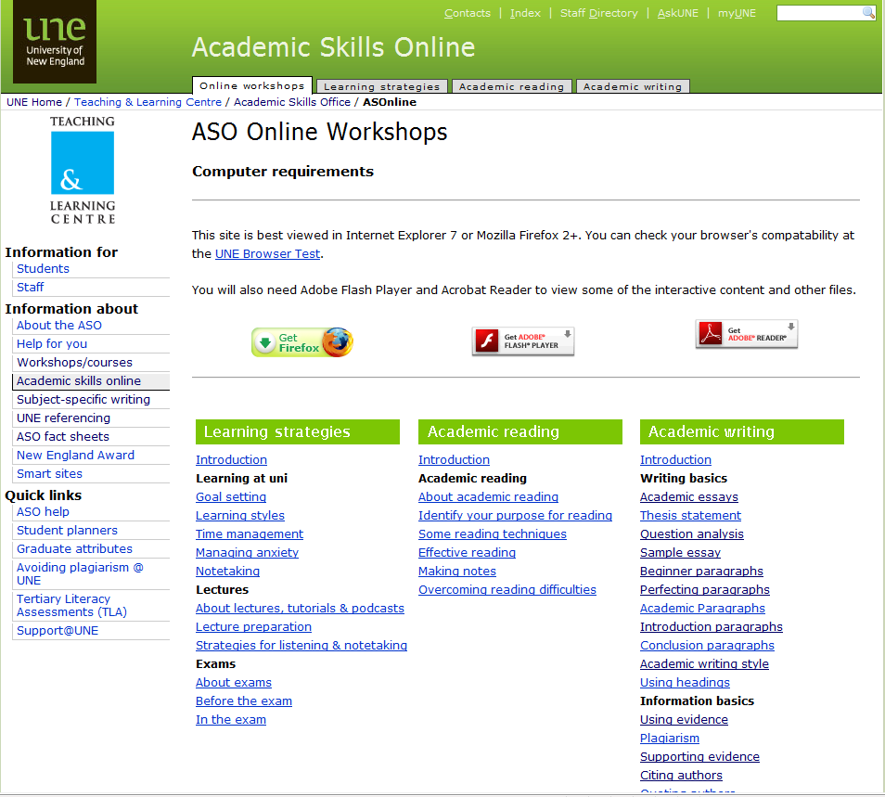
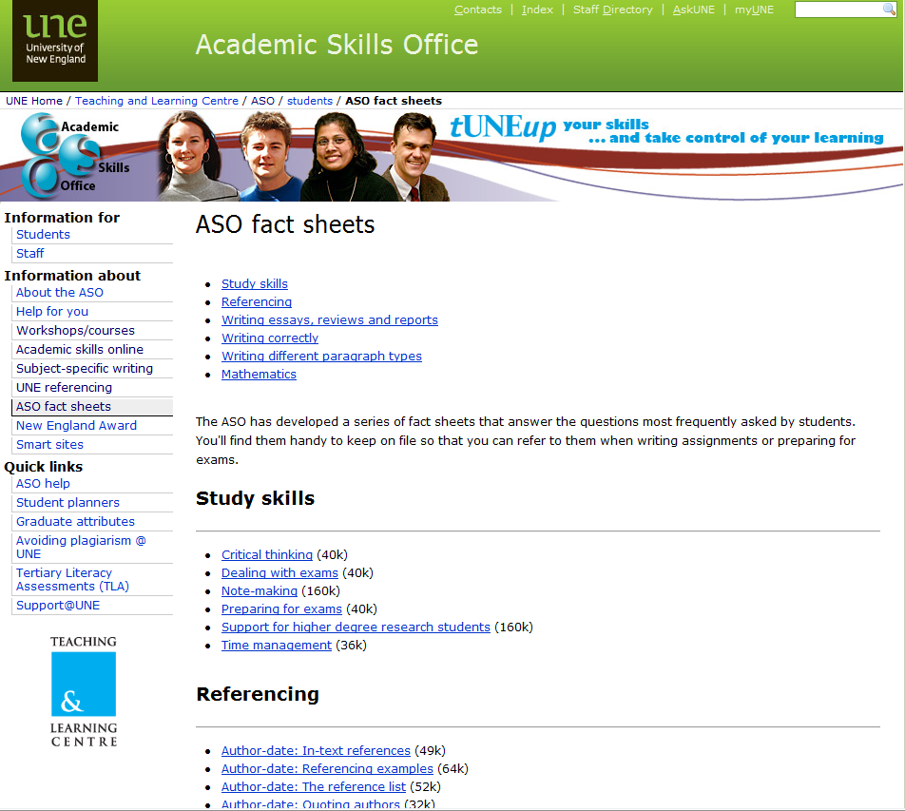
Understand the Question
Notes:
Each of the DDE courses have a written requirement. You must thoroughly read the question as we will discuss later in this presentation. The University of New England has a great reference site to help guide you regarding how to analyze a question. This reference site may help you better understand the questions you will see within the written requirements. In this case, we selected academic skills online workshops; then (click) selected fact sheets; and finally (click) selected “analyzing the question” in order to better understand questions.
Next slide.

Slide 6
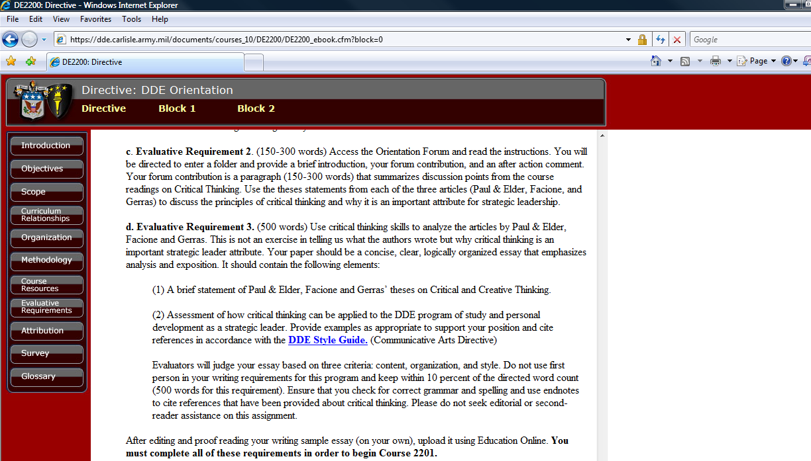
Step 1
Notes:
Now before you start writing down ideas that come to mind on what you want to write about, you need to make sure you understand what you have to write about. Going back to the main presentation for example, our requirement is (click) to write a 500 word essay on critical thinking. After thoroughly reading the requirement, we notice the essay must emphasize (click) analysis and exposition. If we did not understand the type of essay required, go back to the on-line reference for definitions of the different types of essays.
Next slide.

Slide 7
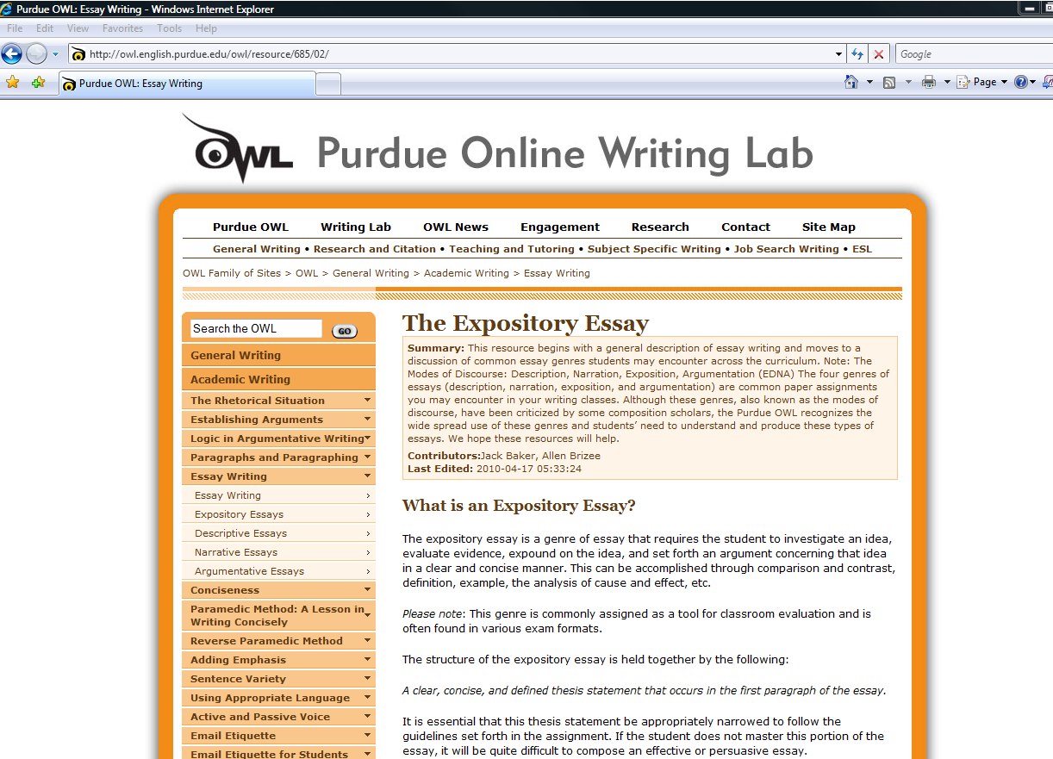
Step 2
Notes:
In this case after reviewing essay writing in the Purdue Online Writing Lab reference site and comparing it to part of the evaluative requirement description to “emphasize analysis and exposition”, we discover the type of essay required for this assignment is a (click) Expository Essay. Remember back to the first presentation regarding Instruction words such as : Compare; Contrast; Define; Describe; Discuss; Evaluate; Explain; Interpret; Outline; Review; ect… This should help you focus on the type of essay you are required to write. In this specific example, we are to emphasize analysis and exposition and this information helps use better determine the type of essay.
Next Slide.

Slide 8
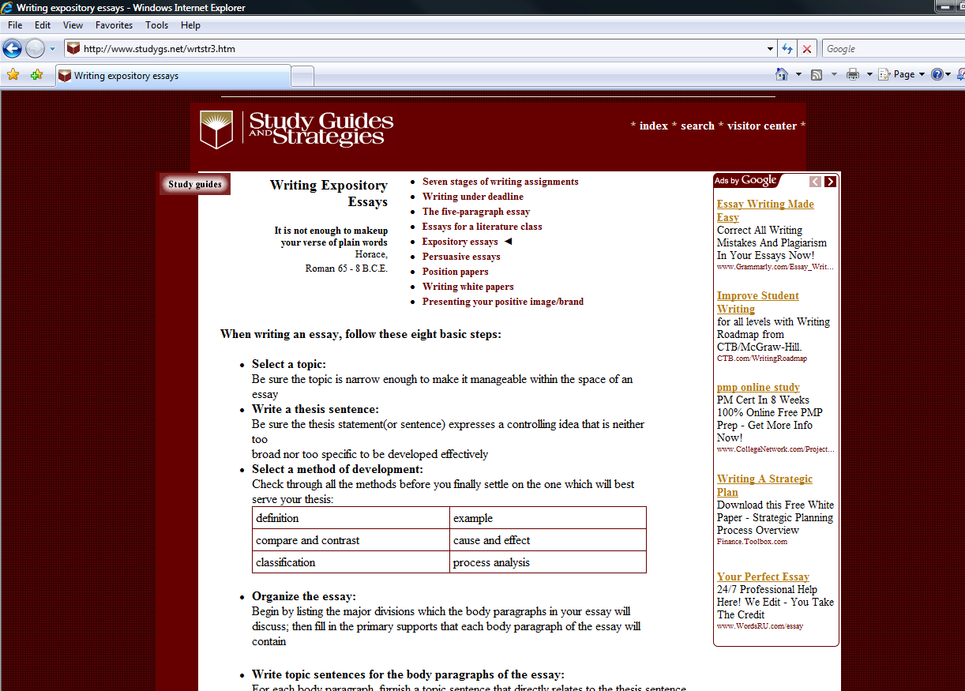
Step 3
Notes:
Here is another on-line reference site. Remember that there are many reference sites which are available for your use to better understand a variety of writing topics. In this example, the free Study Guides and Strategies provide a step by step process to writing an (click) expository essay. Note: The key is making sure you use legitimate on-line reference sites. For example, there are sites which provide papers for a fee. You will be placed in an ethical dilemma should you chose not to write your own paper. The temptation to use someone else's work as your own is great for some students. By staying with legitimate on-line reference sites, you will be able to gather enough information to draft successful papers and using the outline is one technique to assist you in this endeavor.
Next slide.

Slide 9
Review
1. Evaluative requirements
2. Type of essay required
3. Definition of a Expository essay
Definition and schematic of
a five paragraph essay
Notes:
To review thus far, you know the (click) evaluative requirement. You also know the type of essay required and we know the definition of that essay type.
(Click) Now we need to understand what an essay looks like.
Next slide.

Slide 10
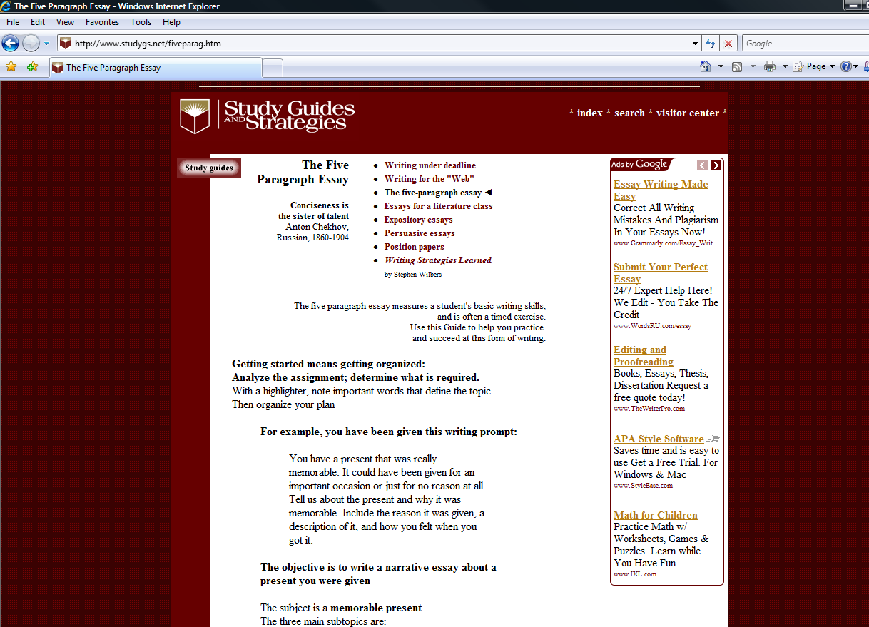
Step 4
Notes:
Before you start with your outline, understand the typical sections within an essay. If required, you can refer to a plethora of online sites for assistance. In this example, we went back to the Study Guides and Strategies web site for information on writing and specifically, the Writing Types section that explains the five paragraph essay. As we scroll down this page we…
Next slide.

Slide 11
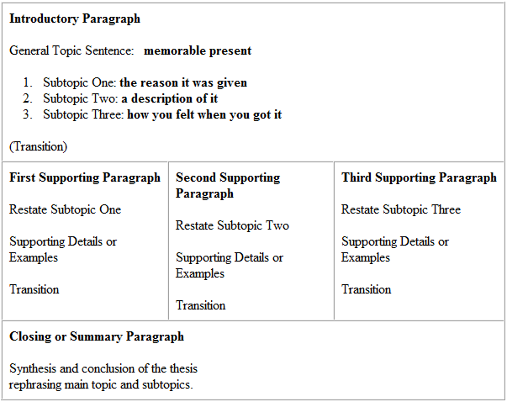
1
2
3
4
5
Notes:
notice a schematic as a guide for a typical five paragraph essay. In this example, it shows an Introduction; three supporting or key idea paragraphs; and closing. This is a typical (click) five paragraph essay. (click) This examples also annotates where I should make my transition into the next supporting paragraph or section. Think of this as your script for the paper.
Next slide.

Slide 12
Review
1. Evaluative requirements
2. Type of essay required
3. Definition of a Expository essay
Definition and schematic of
a five paragraph essay
5. Schematic of an outline
Notes:
To review thus far (click), you know the evaluative requirement, the type of essay, definition of that essay type, and what the five paragraph essay looks like.
(click) Now we need to review the requirement again to ensure we understand the requirement and then we can move onto the outline.
Next slide.

Slide 13
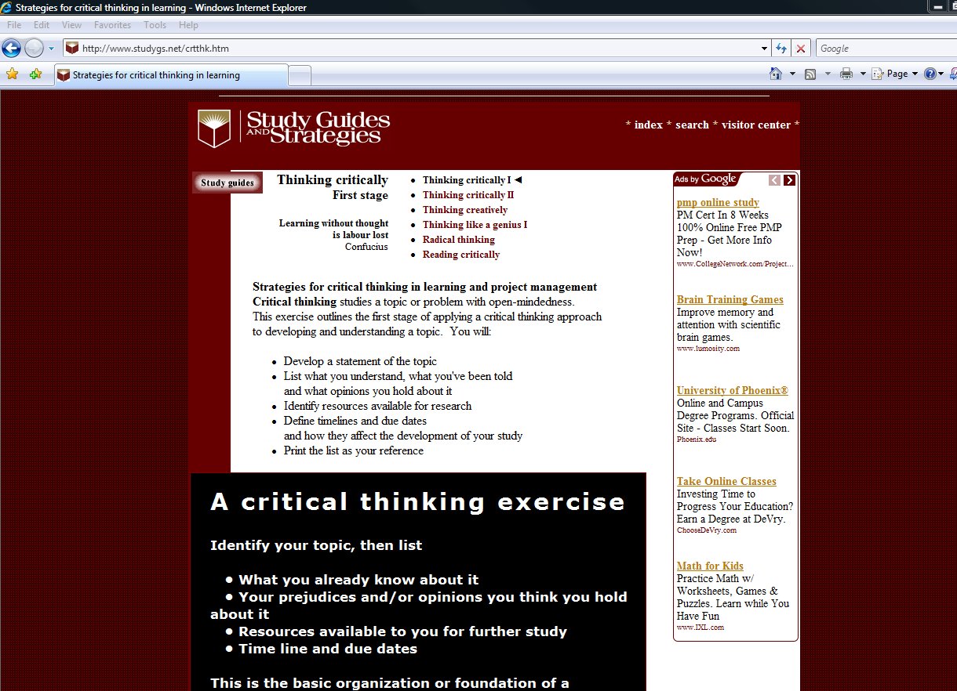
Notes:
Before we start draft our outline however; we must again ensure we understood all elements of the requirement. I reiterate this because many times, students do not fully understand the requirement. In this example, the requirement wants us to use our (click) critical thinking skills. Now the many articles provided to you by the DDE program should be your primary source of information. However, you can augment these with other sources. (click) In this example, we once again use an online source to better understand what thinking critically means.
Now that we fully understand our requirement; know the type of essay required; and have the basic format for an outline, we can begin.
Next slide.

Slide 14
Outline
1. Summarize critical thinking theses from Peter A. Facione, Colonel Stephen J. Gerras, and Dr. Richard Paul and Dr. Linda Elder.
2. Outline why critical thinking is an important attribute in strategic leadership;
3. Assess critical thinking application to the DDE program study to enhance personal development in strategic leadership.
I. Introduction
Key Idea 1
Summary of critical thinking theses from Peter A. Facione, Colonel Stephen J. Gerras, and Dr. Richard Paul and Dr. Linda Elder.
- Evidence example 1
- Evidence example 2
III. Key Idea 2
Why critical thinking is an important attribute in Strategic Leadership
- Evidence example 1
- Evidence example 2
IV. Key Idea 3
Assessment of critical thinking application to the DDE program study to enhance personal development in strategic leadership.
- Evidence example 1
- Evidence example 2
V. Closing
Very brief conclusion on critical thinking as an important attribute in Strategic Leadership
Notes:
Now you start to draft your outline. You may find this process helps you before you write, while others prefer to create an outline while they write the main paper. Again, it is a technique that can assist you in the logical flow of your paper.
We understand that papers generally have an (click) introduction, (click) a main body usually with two or more key ideas, and a (click) closing. You can draft your introduction directly from the evaluated requirement. (click) It is important to capture the questions within the evaluated requirement because your papers content will carry the most weight on AWC Papers and it is critical to address the specifics asked for in each requirement. In this example, there are three requirements (listed in the Introduction).
Now, we also begin to see the main body and key ideas (click) from the three specified requirements. You are starting to visualize the flow and organization of your paper. Within each key idea paragraph, you want to restate the idea or topic; (click) provide supporting details, evidence, or examples; and then transition into your follow on key idea paragraphs. In this example, you already have the restated key idea which will allow you to work on providing the supporting details and evidence. In this example, the outline depicts 2 examples supporting each key idea however, you may only have one or may have several examples. More examples provided in your paper however, can strengthen your key idea paragraph. Finally, your last sentence in any Key idea paragraph or section will be a transition sentence letting the reader know what your next paragraph or section will discuss. Note: Since this is a short essay, we have paragraphs for key ideas however, longer written requirements may need sections to separate your key ideas.
Last paragraph will be your closing. (click) This is a very brief summary or conclusion which links the results of your key ideas depicted in your introduction.
Now that your outline had taken shape, you will want to (click) key in on supporting evidence and critical thinking skills in your key ideas when reading the articles.
Next Slide

Slide 15
Conclusion
1. Evaluative requirements
2. Type of essay required
3. Definition of a Expository essay
Definition and schematic of
a five paragraph essay
5. Schematic of an outline
Notes:
To review thus far, you know the evaluative requirement, the type of essay, definition of that essay type, what the five paragraph essay looks like, and built our outline. We understand that Introduction and summary paragraphs will be short and concise regarding the number of words used in these paragraphs leaving most of your word count for the main body or key idea paragraphs. We also remember that our key idea paragraphs have three parts to them: restated key idea; supporting details, evidence, or examples; and transition to next key idea paragraph.
Building an outline is a technique that can save you valuable time focusing your efforts on answering the evaluative requirement question(s). Our last presentation will go into more detail on actually drafting a paper.

